Slide 1


Wheelora
Smart Two-Wheeler Marketplace
One-stop platform for browsing, comparing & booking bikes, scooters, and EVs
Team QISICONS | Revolutionizing the two-wheeler discovery experience

Slide 2

The Problem We're Solving
Scattered Information
Limited Comparison Tools
Users struggle to find comprehensive two-wheeler data across multiple fragmented websites and platforms.
No unified platform exists for filtering by brand, price, fuel type, and mileage specifications.
Complex Buying Journey
Managing testmultiple rides, showroom visits, and used bike sales requires juggling disconnected services.

Slide 3


Why This Problem Matters
Market Opportunity
Real-World Impact
Two-wheeler demand continues to surge across India and global markets, creating massive opportunities for innovation.
Current platforms focus solely on sales listings without providing complete solutions for buyers and dealers.
EV adoption is accelerating rapidly, yet no central platform exists for comparing electric vehicles against traditional petrol and diesel bikes.
We chose this challenge because it addresses genuine pain points for millions of consumers and thousands of dealers worldwide.

Slide 4
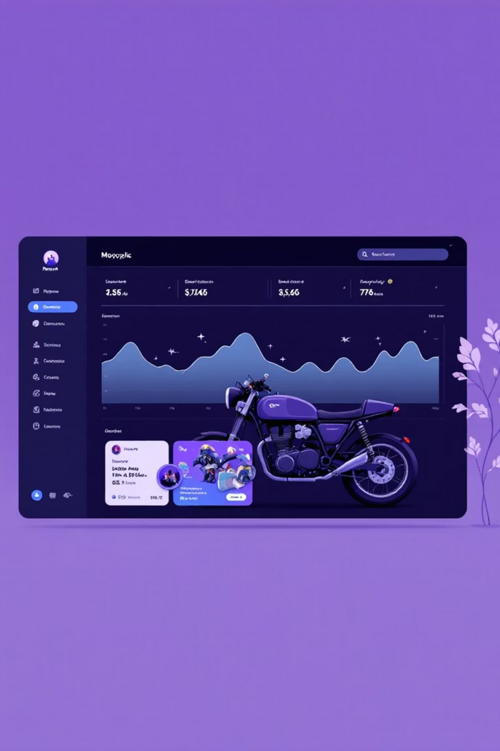




Our Smart Solution:Wheelora
Centralized Browsing
Advanced filtering and search capabilities across all two-wheeler categories and brands.
Detailed Comparisons
Side-by-side model comparisons with comprehensive specifications and real-world performance data.
Financial Tools
Built-in EMI calculators, fuel cost estimators, and financing options for informed decision-making.
Test Ride Booking
Seamless showroom visits and test ride scheduling with dealer integration and notifications.

Slide 5




Technical Architecture
Frontend Layer
React + TailwindCSS with reusable components, React Query caching, and infinite scroll optimization
Backend APIs
Django REST Framework with modular APIs for Users, Dealers, Bikes, and Bookings plus JWT authentication
Data Layer
PostgreSQL with normalized schema, strategic indexing, partitioning, and Redis caching for performance

Slide 6






Core Platform Features
Advanced Search
Model Comparison
Faceted search with filters for brand, price range, fuel type, mileage, and specifications
Side-by-side comparisons with detailed specs, pricing, and performance metrics
Financial Tools
Used Vehicle Hub
Integrated EMI calculator and real-time fuel cost analysis for budget planning
Verified used bike listings with quality checks and dealer authentication
Test Ride Booking
Launch Alerts
Seamless showroom visits and test ride scheduling with dealer coordination
Notifications for upcoming model launches and price updates

Slide 7




AI-Powered Intelligence
Smart Chatbot Assistant
Personalized Recommendations
AI-powered recommendations based on budget and preferences. Example: "Budget ₹1,20,000" → Top 5 matching bikes with specs
Machine learning analyzes browsing history and similar user preferences for targeted suggestions
Dealer Analytics
Advanced dashboard showing sales trends, customer demand patterns, and market insights

Slide 8








Our Competitive Advantage
Complete Integration
Decision Support
First platform combining new bikes, used vehicles, and EVs in one seamless experience.
Comprehensive financial tools including EMI calculators and real-time fuel cost analysis.
Future-Ready
Two-Sided Market
AI/ML recommendations and scalable architecture prepared for market evolution.
Connects buyers and dealers through an optimized marketplace with mutual benefits.

Slide 9
Team QISICONS
Ch.Subramanyam
N.Manikanta
D.Swaraj
Frontend Developer specializing in React, TailwindCSS, and intuitive UI/UX design.
Backend Developer expert in Django REST Framework and scalable API architecture.
Database Engineer focused on PostgreSQL optimization and data modeling excellence.
Y.Rajitha
B.Sailaja
Frontend Deployment Lead – handled frontend deployment (Vercel).
Backend Deployment Lead – handled backend hosting (Render), and database management (Supabase).
Revolutionizing two-wheeler discovery and buying experiences through innovative technology solutions.

